Slide 1
Temple Newsam Timeline
The story of an extraordinary house.
Free learning resources from arts, cultural and heritage organisations
^{mylearning.org}

Slide 2
Temple Newsam Timeline
This presentation follows the development of Temple Newsam from its first mention in the Doomsday Book to its present day ownership by Leeds City Council.
Some slides are linked to further information, which can be accessed by clicking on the symbols.
To progress through the timeline, click anywhere on the slide.
Free learning resources from arts, cultural and heritage organisations
^{mylearning.org}

Slide 3
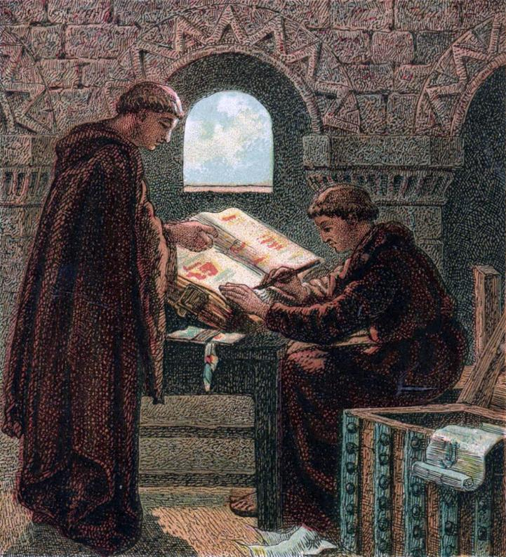
1086
1541
1996
1086
The ‘Manor of Newsam’ first appears in the Doomsday book.
‘Manor of Newsam’ means ‘New Houses’
Image: Joseph Martin Kronheim | Wikimedia Commons
^{mylearning.org}

Slide 4
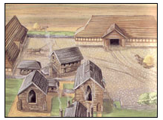
1086
1541
1996
1155
The Manor of Newsam is given to the Knights Templar. These are the soldier monks that guard the roads for the pilgrims travelling to Jerusalem.
The ‘Manor of Newsam’ is renamed ‘Temple Newsam’. At this stage there is probably a farmstead on
the site, but no house.
Artist impression of what Temple Newsam may have looked like.
Image: West Yorkshire Archive
^{mylearning.org}

Slide 5
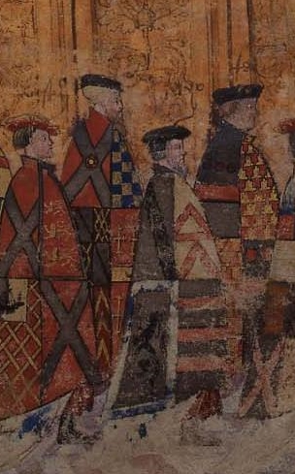
1086
1541
1996
1500 - 1520
Four sided plan / picture
Lord Darcy builds Temple Newsam house.
Lord Darcy is one of most powerful men in Yorkshire and he designs Temple Newsam in a style that shows off this power.
He makes Temple Newsam the largest house in Yorkshire and builds it with four sides with a courtyard in the middle. With towers and battlements, the house looks like an imposing castle.
Lord Darcy (2nd from right)
Image: Leeds Museums and Galleries

Slide 6
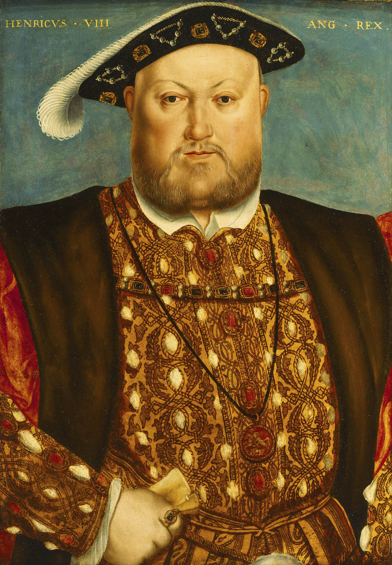
1086
1541
1996
1537
King Henry VIII chops off Lord Darcy’s head for his part in The Pilgrimage of Grace.
This was a Yorkshire uprising against the King’s split with the Roman Catholic Church (the Reformation).
Henry VIII gives Temple Newsam to his niece, Lady Margaret Lennox.
Henry VIIII
Image: Public Domain
^{mylearning.org}

Slide 7
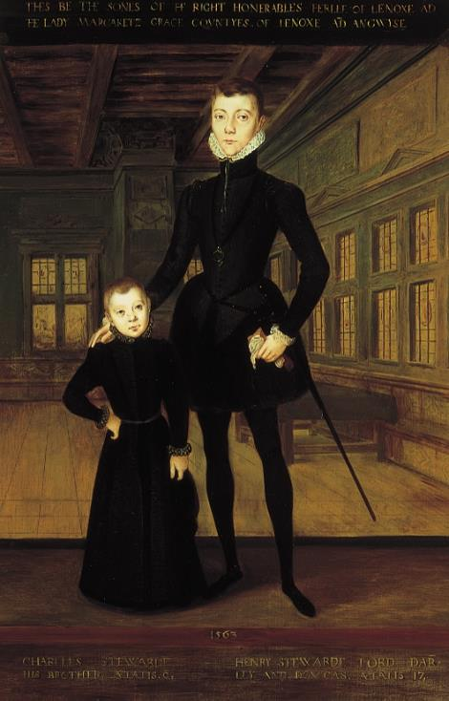
1086
1541
1996
1545
Margaret’s son, Henry Lord Darnley, is born at Temple Newsam.
The painting here shows Lord Darnley with his younger brother, Charles. They are standing in the Great Hall at Temple Newsam.
Image: © Leeds Museums and Galleries
^{mylearning.org}

Slide 8
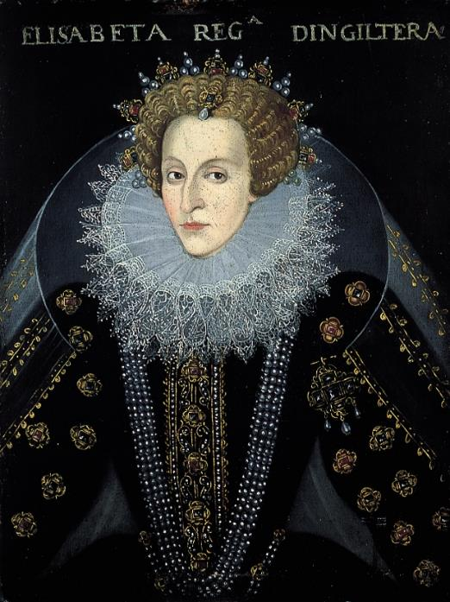
1086
1541
1996
1565
Queen Elizabeth I is on the throne, but Margaret is desperate for her son, Lord Darnley to become King. She arranges for him to meet Mary Queen of Scots and the couple marry in secret.
Soon after, Queen Elizabeth finds out about the marriage and imprisons Lady Margaret Lennox in the Tower of London in anger.
The Queen seizes Temple Newsam and it stays as a royal property for nearly 40 years.
Lord Darnley and Mary Queen of Scots have a son (who will later become King James 1).
Queen Elizabeth I
Image: © Leeds Museums and Galleries

Slide 9

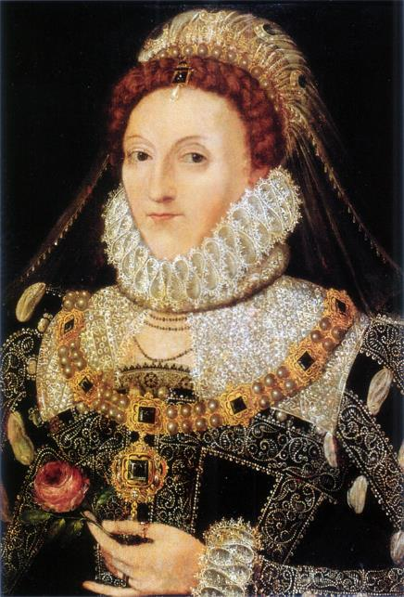
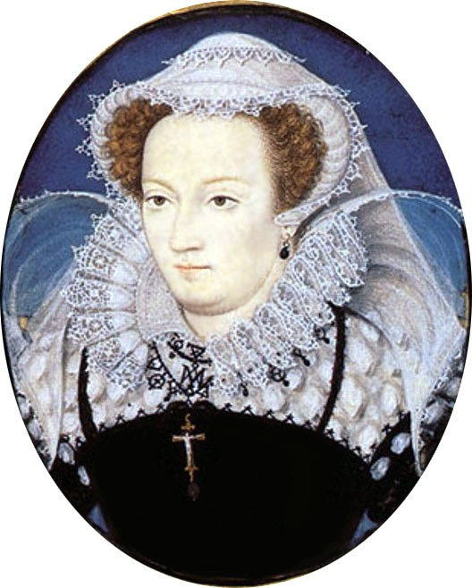
1086
1541
1996
1567
Henry Lord Darnley is found strangled.
The murder has never been solved, but there are many suspects. Two main suspects for ordering the murder are:
Queen Elizabeth I
In marrying Mary Queen of Scots, Lord Darnley was now threat to Queen Elizabeth as he could challenge her for the throne.
Maybe Queen Elizabeth thought it was better to get rid of him and remove the threat forever.
His wife, Mary Queen of Scots.
Lord Darnley had murdered Mary’s closest advisor and musician right in front of her. It could have been out of jealousy but we don’t know.
Maybe Mary murdered Lord Darnley in revenge?
Other suspects include:
Mary’s step-brother,
Mary’s advisor’s brother,
James Balfour,
The Earl of Bothwell…. and more.
Lord Darnley was not a popular man it seems!
Mary Queen of Scots
by Nicholas Hilliard (1578)
Image: Public Domain | Wikimedia
Queen Elizabeth I
Attributed to Nicholas Hilliard
Image: Public Domain | Flickr

Slide 10
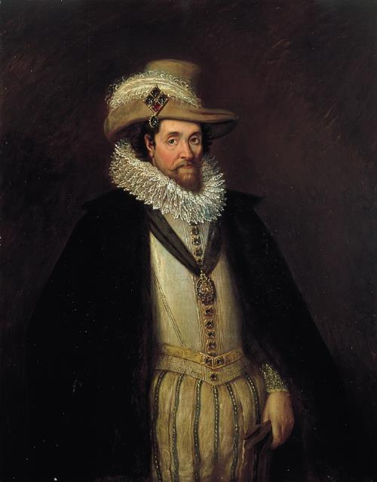
1086
1541
1996
1603
Queen Elizabeth dies without having children, so the son of Lord Darnley and Mary Queen of Scots, James 1 inherits Temple Newsam.
James 1 gives Temple Newsam to his cousin Ludovic, the Duke of Lennox.
James I | Rhoda Sullivan | 16th C
Image: © Leeds Museums and Galleries
^{mylearning.org}

Slide 11
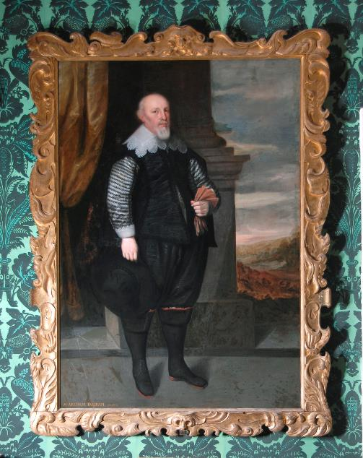
1086
1541
1996
1622
The Duke of Lennox is in lots of debt, so he sells Temple Newsam to property developer Arthur Ingram for £12,000.
Using a historical currency converter, that £12,000 would be about £2 million today.
(source: www.easuringworth.com)
Arthur Ingram
Image: © Leeds Museums and Galleries

Slide 12
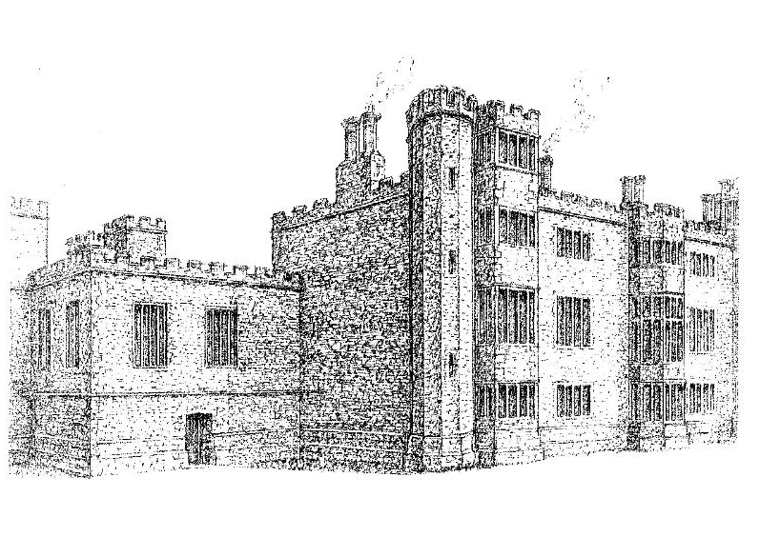
1086
1541
1996
1636
Fire rips through the east wing of Temple Newsam and Arthur Ingram then demolishes the remains, along with the north and south wing.
He leaves only the west wing standing. This is the Tudor Wing from Lord Darcy’s original building that you can still see today at Temple Newsam.
A historical drawing of Temple Newsam House
© Leeds Museums and Galleries
Arthur then re-builds the north and south wing and the outside of these are what you see today. The East wing is never rebuilt.
^{mylearning.org}

Slide 13
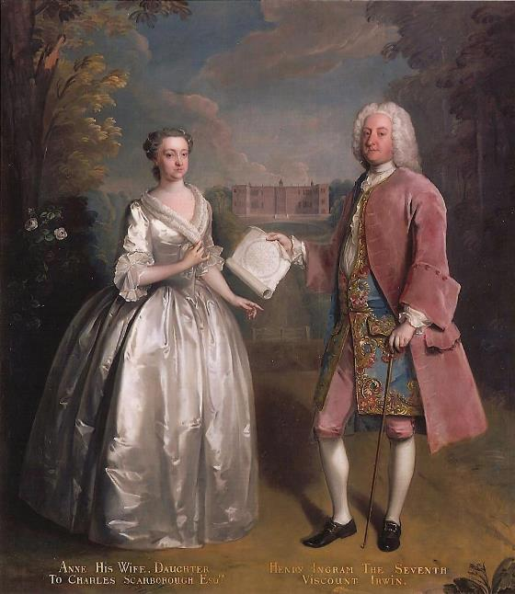
1086
1541
1996
1642 - 1758
Temple Newsam passes down the Ingram family line.
Edward Ingram inherited at the age of 15. He collected many paintings for the house on his Grand Tours.
Henry Ingram marries heiress Ann Scarborough and in 1736 major alterations to the Picture Gallery are made to display the collected paintings.
Henry Ingram and his wife, Anne Irwin
Photo: Norman Foster
© Leeds Museums and Galleries

Slide 14
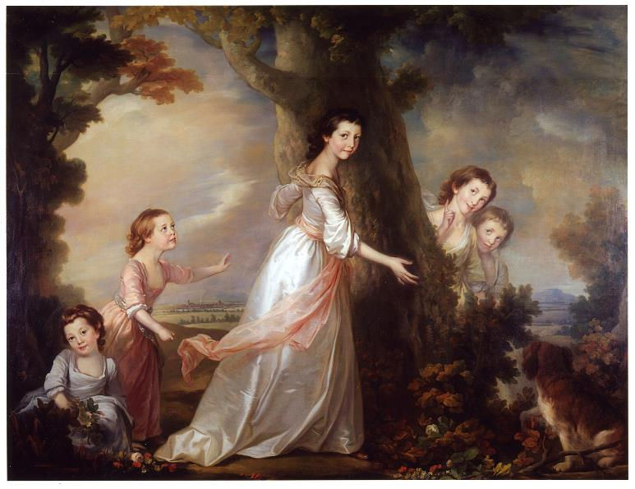
1086
1541
1996
1806
Charles Ingram inherits Temple Newsam. He marries a wealthy heiress, Frances Shepheard, and using her money, Temple Newsam is transformed.
The park is re-landscaped by Capability Brown.
Together, they have five daughters. The eldest two of these, Lady Hertford and Lady William Gordon inherit Temple Newsam in 1806.
The five daughters of Charles and Frances Shepheard
© Leeds Museums and Galleries

Slide 15
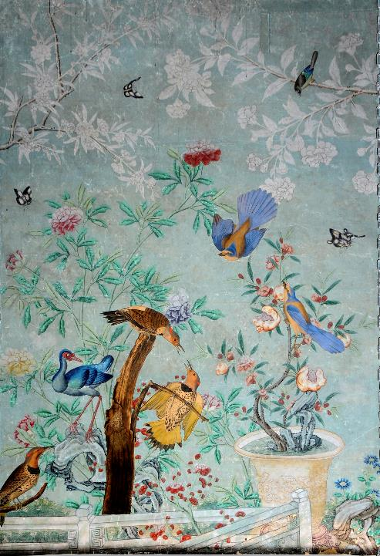
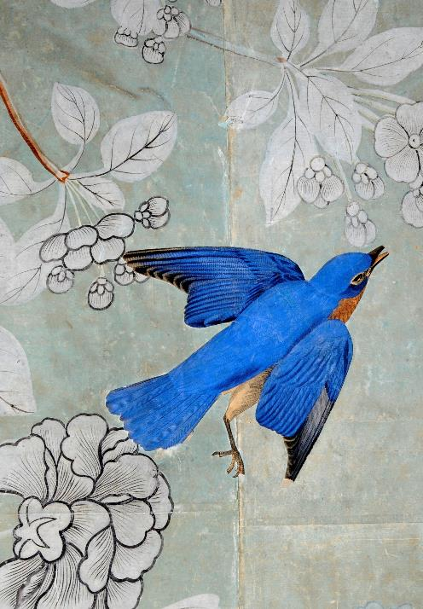
1086
1541
1996
1806
Lady Hertford is friends with the Prince of Wales (future King George IV). He gifts her the precious Chinese wallpaper.
In the 1820’s in a burst of creativity, Lady Hertford took her copy of ‘The Birds of America’ by James Audubon, cut out some of the birds and stuck them on the Chinese wallpaper.
‘Birds of America’ featured beautiful life size paintings of each bird, and was one of the most expensive books ever produced!
Part of the Chinese Wallpaper
Photo: Norman Foster
© Leeds Museums and Galleries

Slide 16
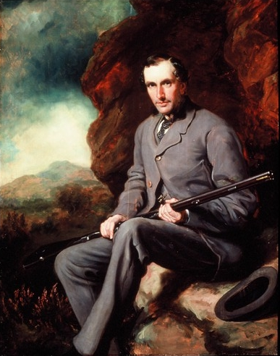
1086
1541
1996
1871
Lady Hertford dies, and the third sister’s son, Hugo Charles Meynell Ingram inherits Temple Newsam.
His son, Hugo Francis is the last direct descendent of Sir Arthur Ingram. He marries Emily Wood.
Hugo dies in 1871, leaving Emily as the sole proprietor of not just Temple Newsam, but 15 other estates in Yorkshire, Lincolnshire and Staffordshire.
Hugo Francis Meynell Ingram
Image: © Leeds Museums and Galleries

Slide 17
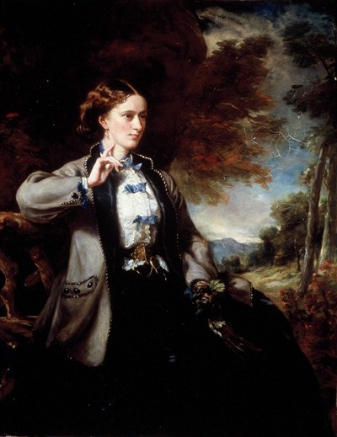
1086
1541
1996
1904
Emily Wood is now almost as rich as Queen Victoria herself!
She spends a lot of money developing Temple Newsam.
One of her house parties, includes the Duke and Duchess of York, (later King George V and Queen Mary) as guests.
Late in life, Emily choses to live in the Picture Gallery.
Honorable Emily Meynell Ingram
Image: © Leeds Museums and Galleries

Slide 18
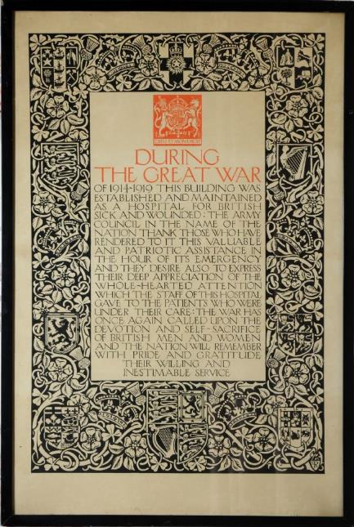
1086
1541
1996
1904
Emily dies, and her eldest nephew, the Earl of Halifax inherits Temple Newsam.
Between 1914 and 1918, the house becomes a hospital for soldiers injured in WW1. It is staffed by nurses from the Voluntary Aid Detachment (VAD).
Image: © Leeds Museums and Galleries
^{mylearning.org}

Slide 19

1086
1541
1996
1922
Leeds City Council buys Temple Newsam for £35,000.
The house is just an empty shell, as all the original contents have either been kept by the family or sold.
^{mylearning.org}

Slide 20
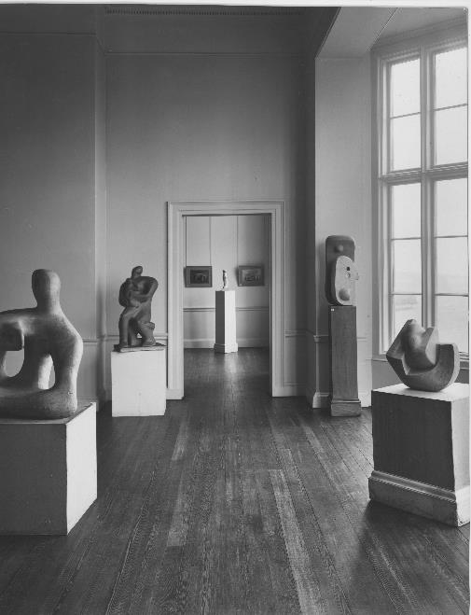
1086
1541
1996
1940s
Temple Newsam house is an art gallery, showing works by young artists such as Henry Moore and Barbara Hepworth.
During WW2, paintings from the City Art Gallery are brought to Temple Newsam to try and keep them safe from bombing raids.
View of the south wing of Temple Newsam as an art gallery
© Leeds Museums and Galleries

Slide 21
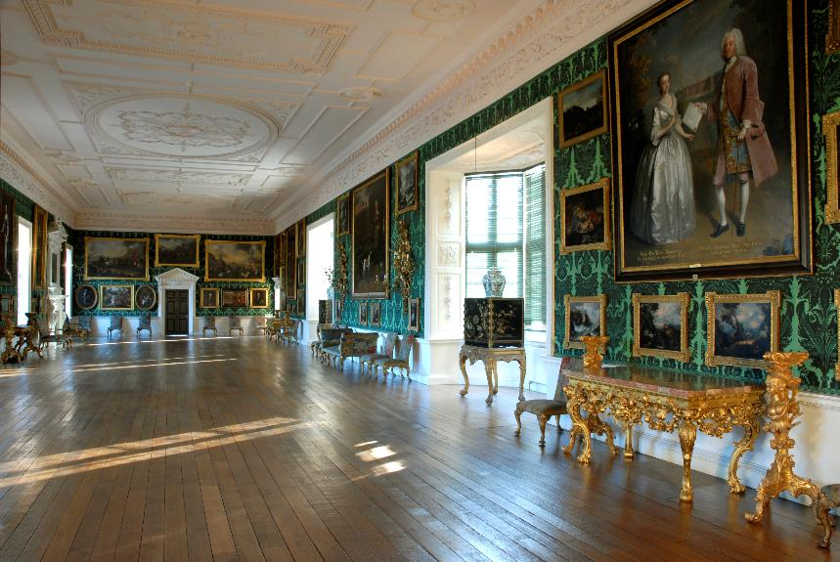
1086
1541
1996
1996
Leeds City Council restores Temple Newsam for its 250th Anniversary.
Many heirloom paintings and works of art that had been sold or moved elsewhere are tracked down and returned to the house.
Nearly half of the paintings you see in the house today are the original contents, but they had to be bought back by the Council.
^{mylearning.org}

Slide 22
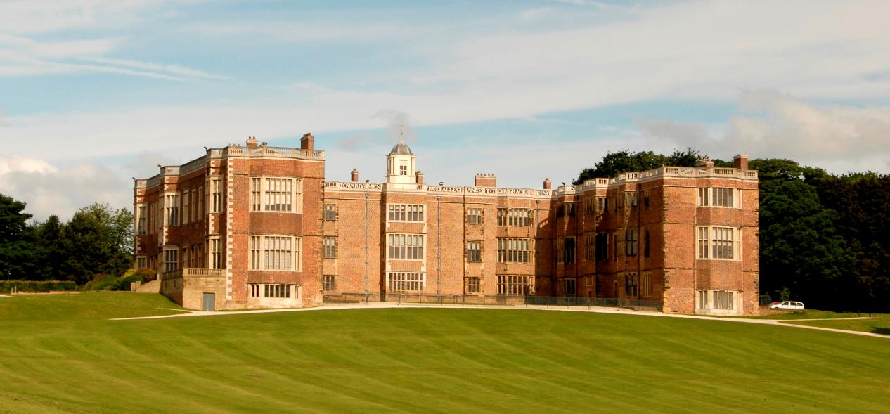
Present Day
Today, Temple Newsam is still owned and managed by Leeds City Council and is open to the public.
Why not come visit and explore this great historic house for yourself?

Slide 23
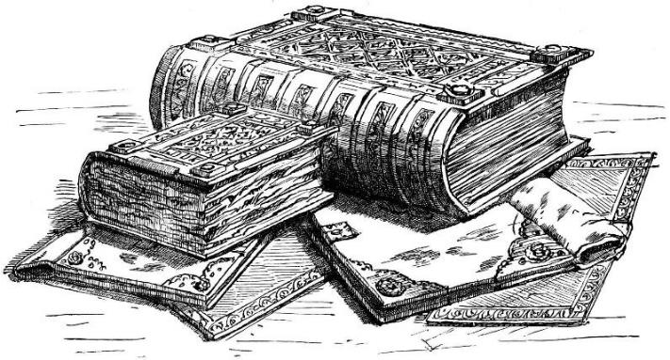
Doomsday Book
The Doomsday Book was ordered by King William the Conqueror, and completed in 1086.
William wanted to reassert the rights of the King after all the upheaval of the Norman Conquest.
The purpose of the book was to find out how much tax was owed during the last King’s reign, and therefore how much William could collect from the people. It did this by surveying who held what land in England.
Image: Public Domain | Wikimedia
The Doomsday book is an incredibly important historical document and is the oldest public record in England.

Slide 24
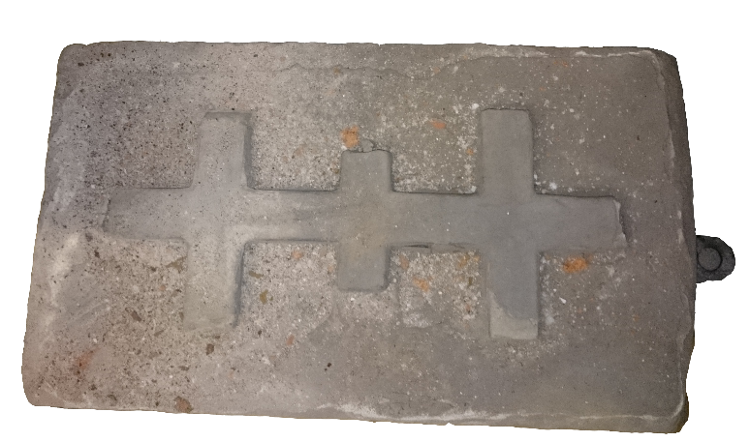
Knights Templar
In 1991, an archaeological dig at Temple Newsam found evidence of a great barn down near the River Aire in the present grounds of the house.
This may have been the site of the Knights Templar preceptory (a central lodge).
Why do you think they based themselves next to a river?
The Knights Templar did not have to pay certain taxes and a cross was put on Templar buildings to show that they were exempt.
Knights Templar cross carved into stone
Image: © Leeds Museums and Galleries

Slide 25
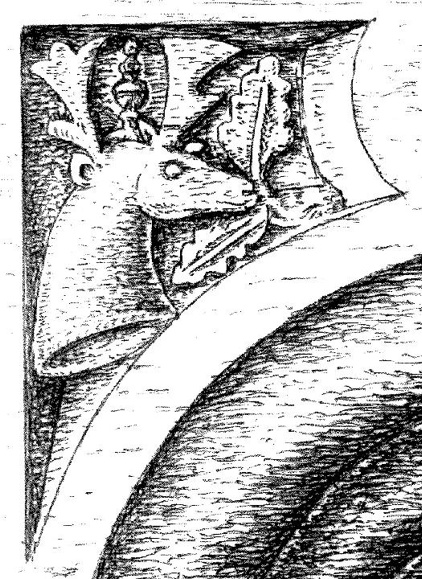
Lord Darcy’s Stag Emblem
Lord Darcy was soldier, mercenary, a courtier and a man of adventure.
His emblem is the stag. Why do you think he chose this as his symbol?
Stags represent power and strength and are seen as a very noble animal, so he may have been wanting to communicate this to his peers.
The stag emblem can be seen throughout Temple Newsam. The drawing on the left is from a carving in the top left of a doorway at the house.
Image: Leeds Museums and Galleries

Slide 26
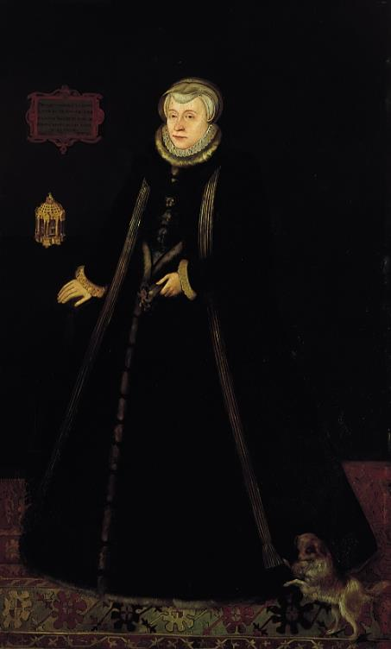
Lady Margaret Lennox
Lady Margaret Lennox was the mother of Lord Darnley.
She was thrown into the Tower of London dungeons by Queen Elizabeth I after the queen heard of the marriage of Lord Darnley and Mary, Queen of Scots.
Some people believe that the birdcage you can see in the painting represents the Tower of London.
Lady Margaret Lennox | Rhoda Sullivan
Image: © Leeds Museums and Galleries

Slide 27
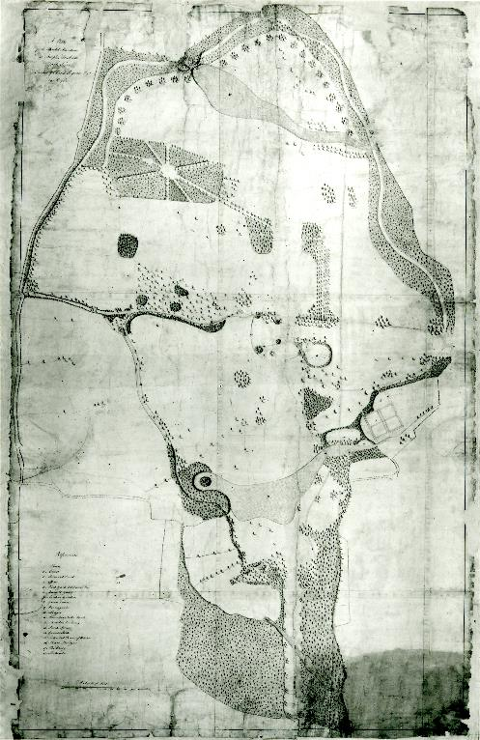
Capability Brown
Capability Brown (real name: Lancelot Brown) was an English landscape architect born around 1715.
In 1762 Capability Brown designed a range of improvements to the Temple Newsam landscape. He broke up the strict symmetry of past designs in favour of a more ‘natural’ look, that was popular at the time.
Plan of Temple Newsam by
Capability Brown
Image: © Leeds Museums and Galleries

